Slide 1
Presentazione del Volume
Webinar 15 luglio 2020
“L’interazione online nel Companion Volume del Quadro Comune Europeo di Riferimento per le Lingue.
Un progetto pilota italiano”
A cura di F. Benedetti,
L. Cinganotto, G. Langé
Nome: Cinzia Masia
Scuola: Istituto istruzione Superiore “N. Pellegrini”, Sassari
Titolo: Retail Trade Across Europe, eTwinning project.

Slide 2
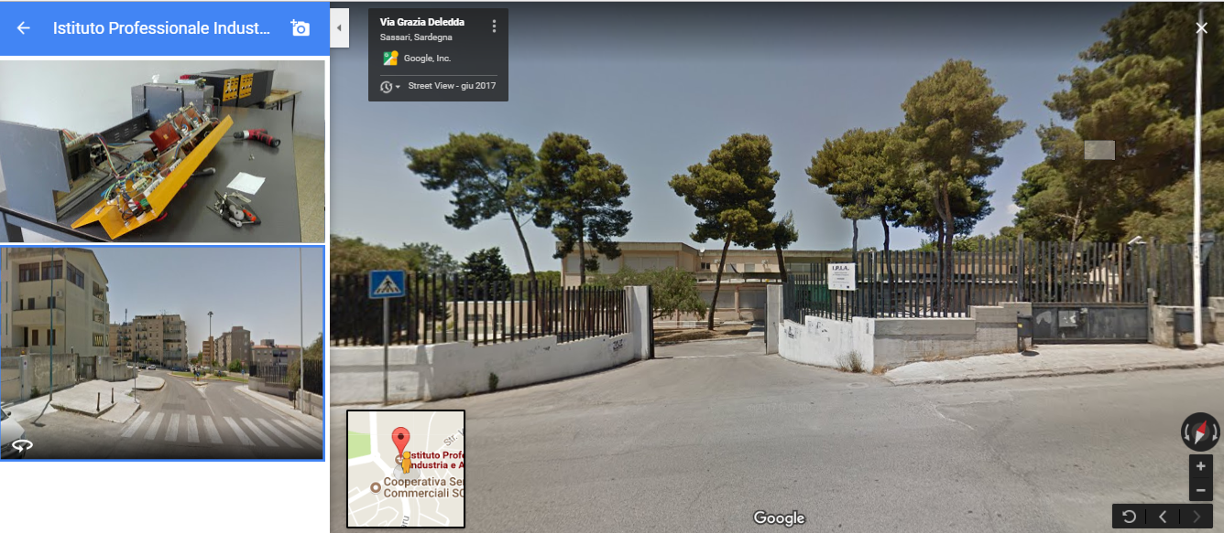
CONTEXT
Upper secondary school (Vocational schoo): Istituto Professionale Industria e Artigianato – I.P.I.A., Sassari
Class: 3^ B Apparati
Number of students: 23
Language level: A2 CEFR

Slide 3
eTwinning project “RETAIL TRADE ACROSS EUROPE” School partners: INS Joan Brossa, Barcelona- Spain; Dobnikar Ekonomska šola, Ljubljana, Slovenia. AIMS
CONTENT
LANGUAGE
Use appropriate dictionary and grammatical structures to communicate and interact with pairs/ partners.
Express personal opinions.
Improve communicative skills
Research and exchange information about partners
Explore and know the trade business in each city and compare it with the partner schools’ cities.
Retail trade and sustainability

Slide 4
CEFR Descriptors Scales
Online Conversation and Discussion - A2
Can introduce him/herself and manage simple exchanges online, asking and answering questions and
exchanging ideas on predictable everyday topics, provided enough time is allowed to formulate responses, and
that he/she interacts with one interlocutor at a time.
Can engage in basic social communication online (e.g. writing a simple message on a virtual card for a special
occasion, sharing news and making/confirming arrangements to meet).
Goal oriented Online Transactions and Collaboration - A2
Can ask basic questions about the availability of a product or feature.
Can respond to simple instructions and ask simple questions in order to accomplish a shared task online with
the help of a supportive interlocutor.
Collaborating in a group- A2: FACILITATING COLLABORATIVE INTERACTION
Can collaborate in simple, practical tasks, asking what others think, making suggestions and understanding responses, provided
he/she can ask for repetition or reformulation from time to time.

Slide 5
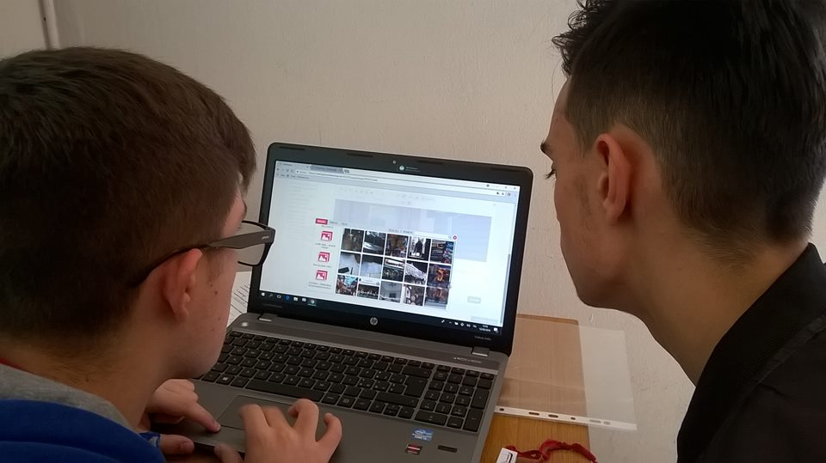
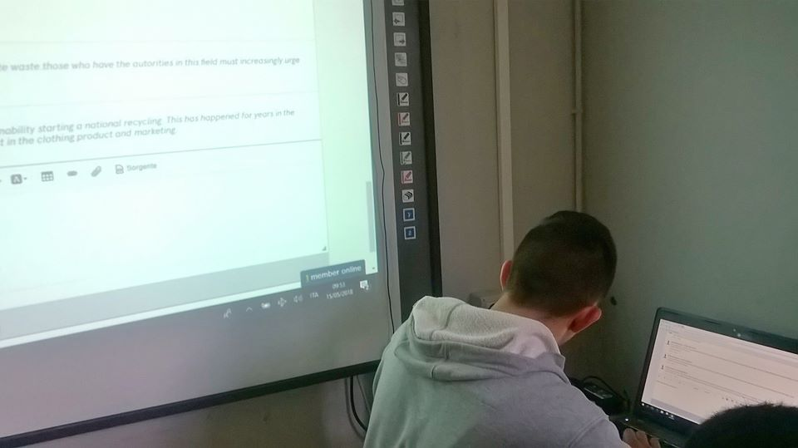
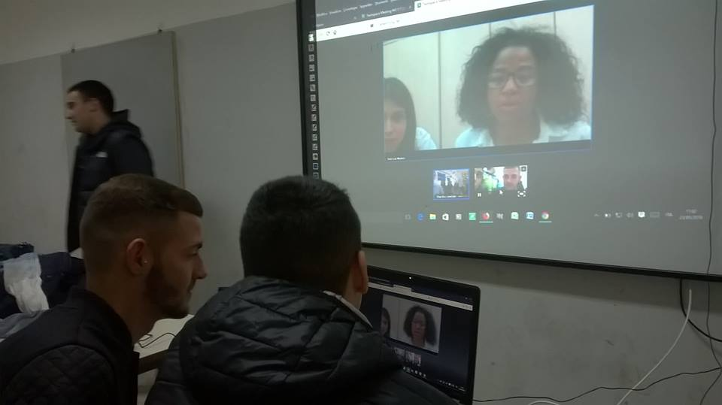
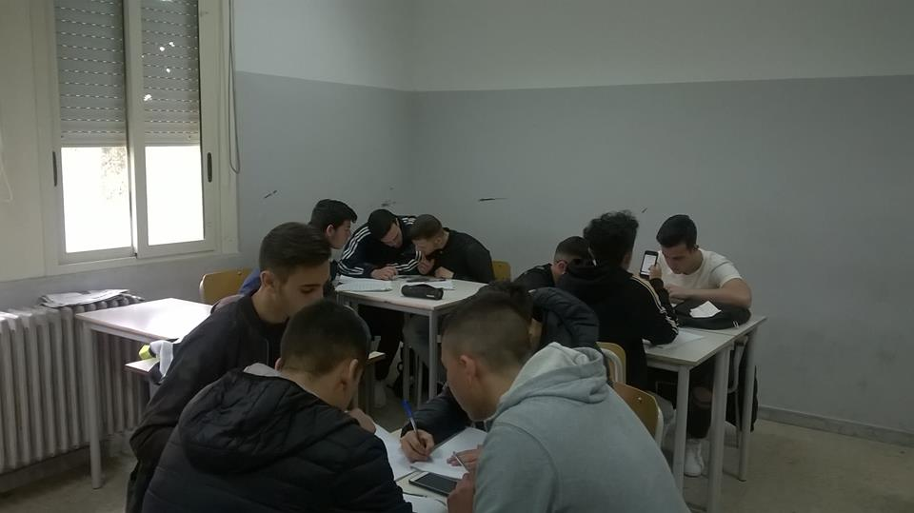
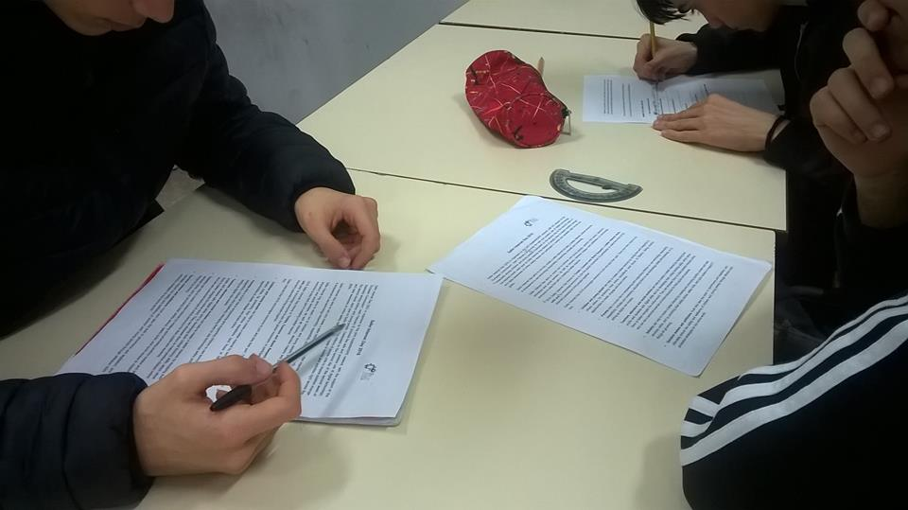
CLIL & BYOD
Face to Face
Online activities
Pair work (peer tutoring)
Group work (cooperative learning)
Plenary
Twinspace: Padlet, Forum, chat
Online meeting:videoconferences
Products: maps, PPP,videos.

Slide 6
Rubrics and grid
Observation grid
Rubrics
Teachers’ feedback
…The descriptors were really useful to focus on our students’ speaking ability. Students had the chances to prepare their interviews and to put them into practice talking with foreign partners communicating in a “natural context” thanks to eTwinning platform (videoconference)…

Slide 7
Thanks for your attention
Prof.ssa Cinzia Masia
attasonitabas@tiscali.it

