Slide 1
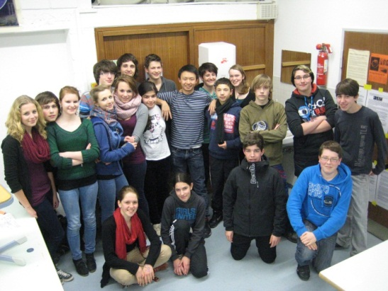
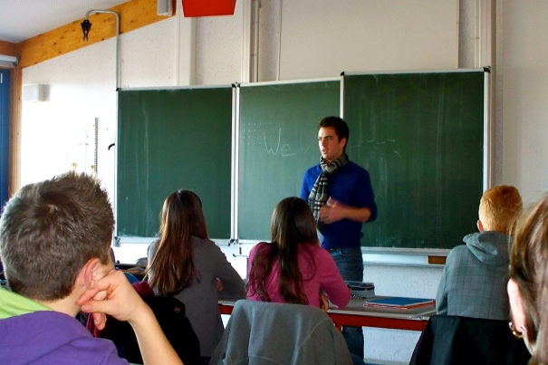
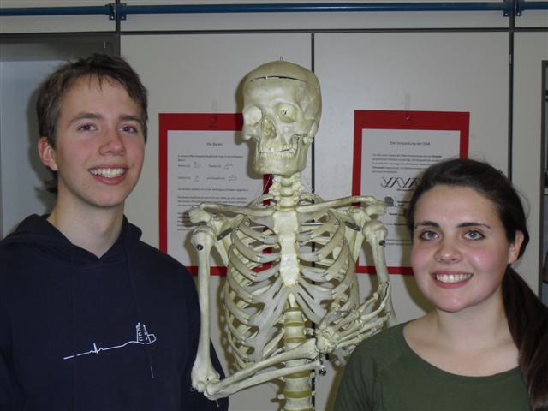
Global Teaching Labs/Highlights for High Schools
Serenella Sferza
MIT-Italy Program Co-director

Slide 2

What is the MIT-Italy Program?
One of the 13 MIT country programs that make up MISTI
A MIT program—self interested—but for the common good
Long term collaboration, reciprocal benefit
3 main activities:
Internships abroad for MIT students ( about 60 a year)
Research collaborations through seed funds ( Polimi, Polito, Unipi)
Showcase Italian excellence for MIT students and faculty, and cultural training
ITALY

Slide 3
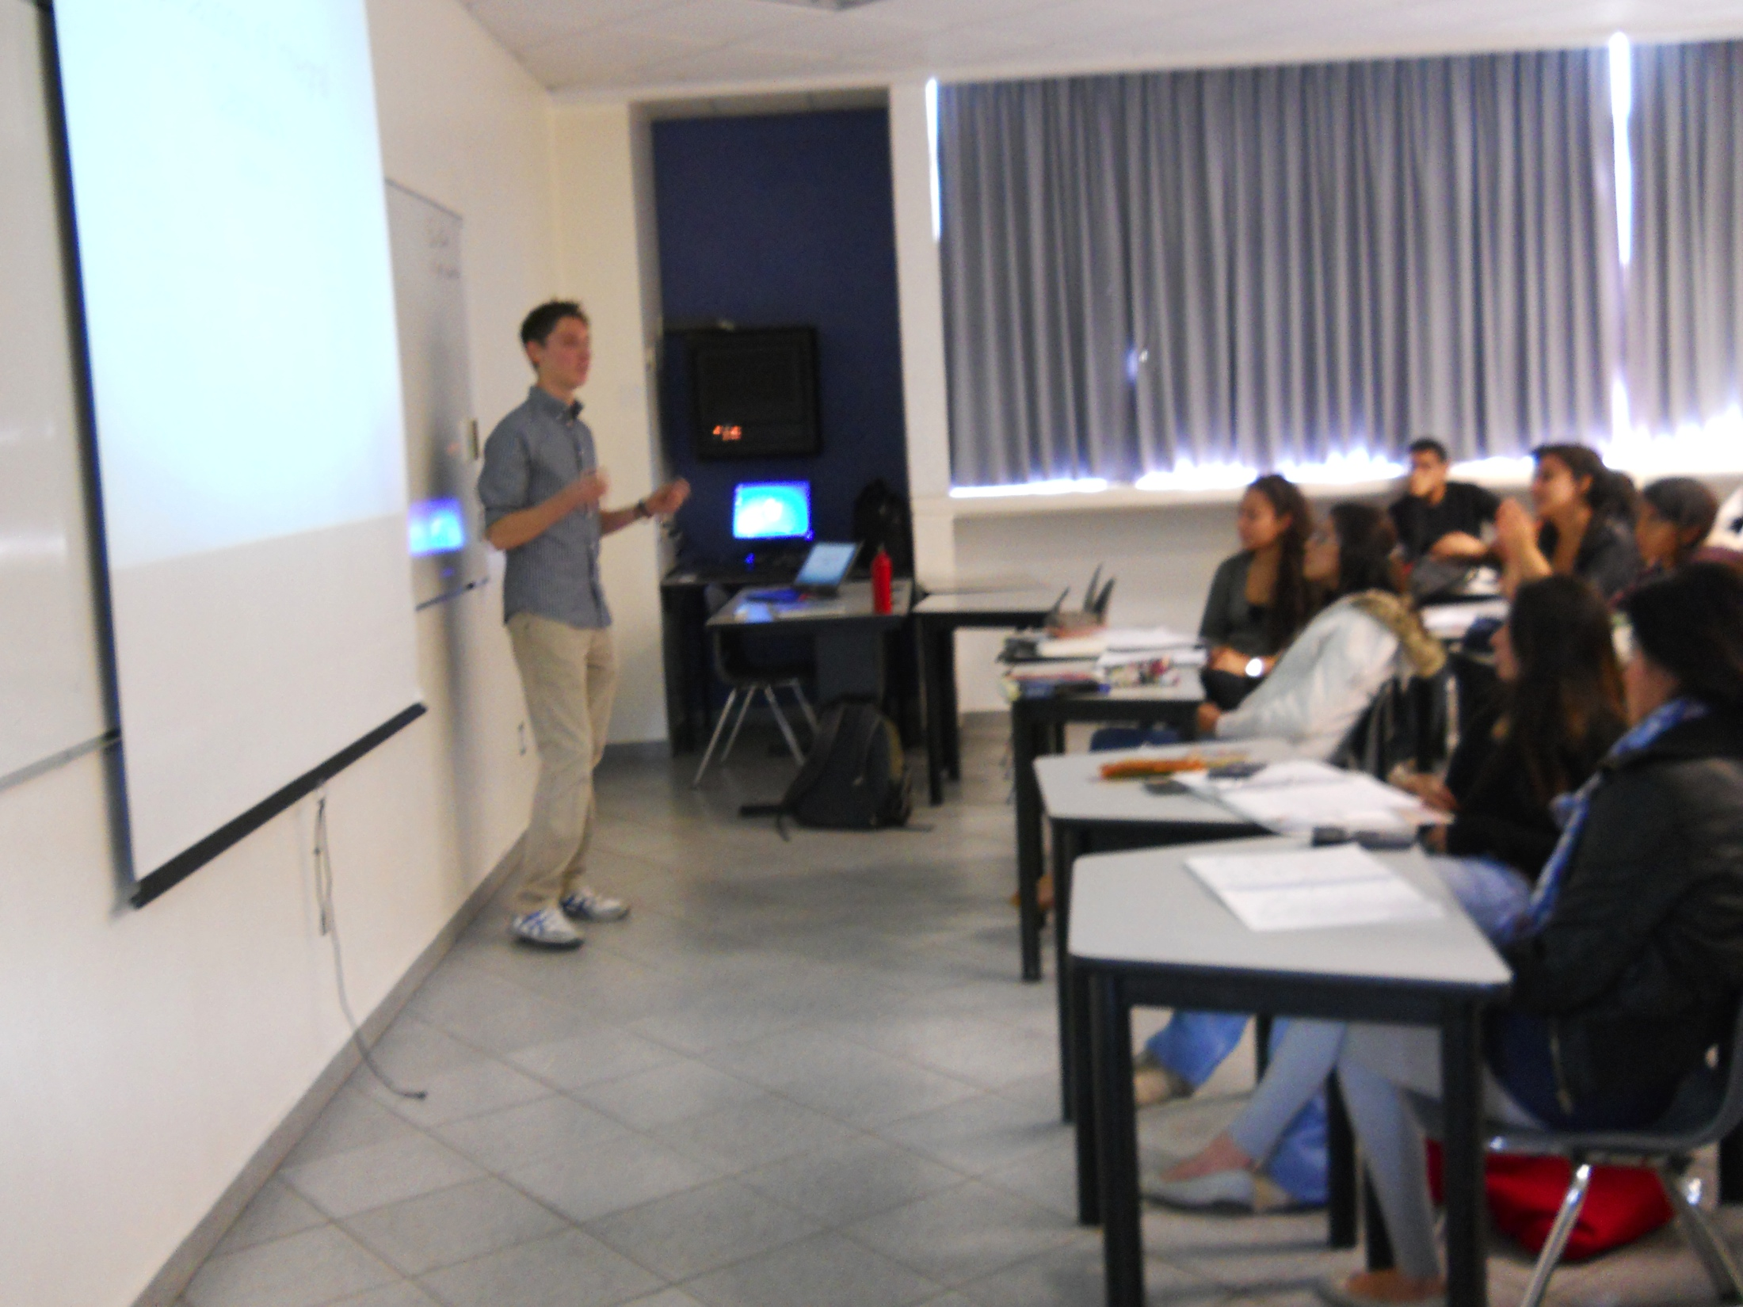
Why the Global Teaching Labs ?
Created in 2007 by country specific and MIT circumstances
Italy: notoriety of MIT brand, great education, but theory-focussed
MIT: new interest in education and in teaching.
Two sets of parents: MIUR and Lombardy’s Rete
Great control experiment
Over 5 years, about 120 MIT students have taught STEM classes in about 40 Italian high schools.
Similar programs have sprouted in Germany, Israel and Mexico.

Slide 4
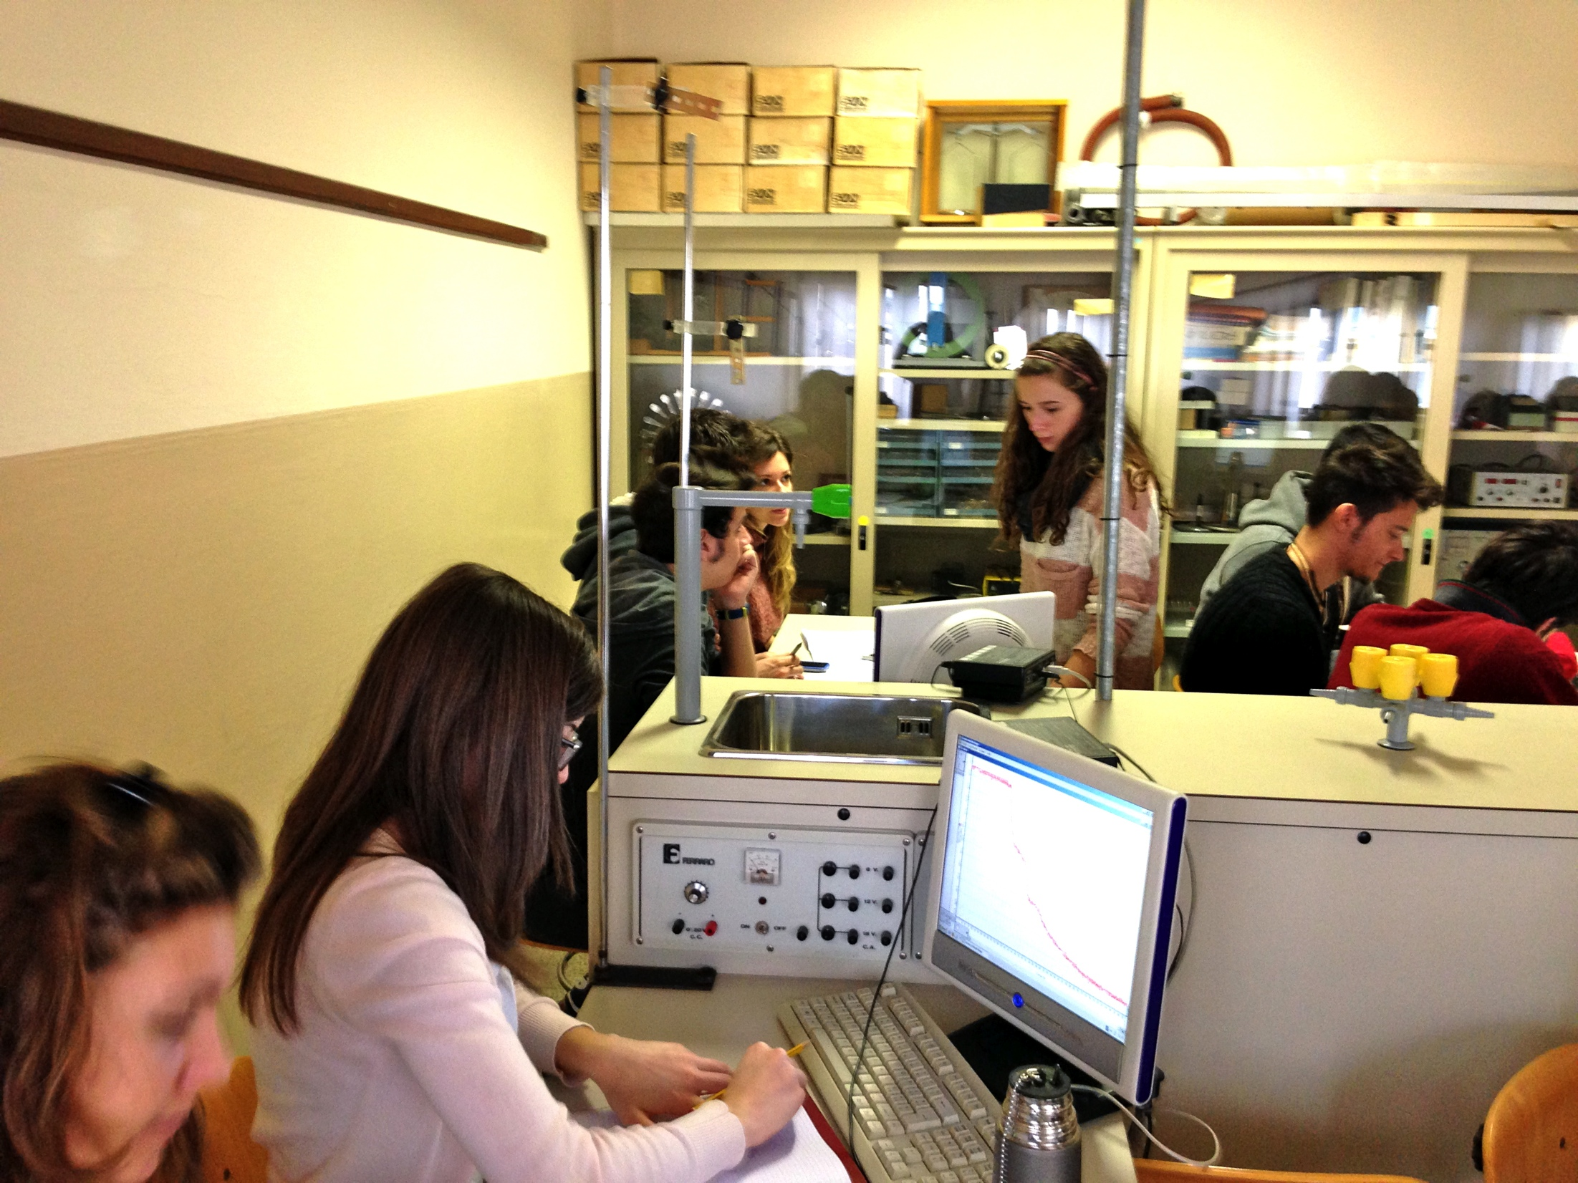
HOW do the GTLS work
Students: selected based on their academic strength , teaching experience , enthusiasm, communication skills and Italian.
Trained at MIT.
Teach one ( or two) subjects in English about 20 hours a week . Hosted by families. Stipend and airfare.
Host schools: voluntary associations/selected by ministry
GoalsL:The focus is on HOW to teach
The purpose is to encourage student participation and stimulate teacher experimentation. Language training as well

Slide 5
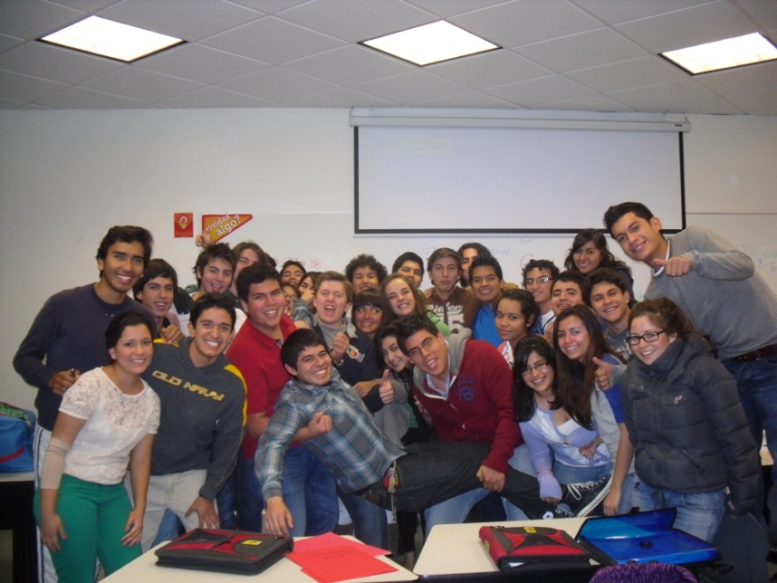
Feedbacks
Quite positive
MIT: very competitive selection
Italy: repeat participation
3 out of 4 MIT Italian freshmen exposed to GTLS

Slide 6
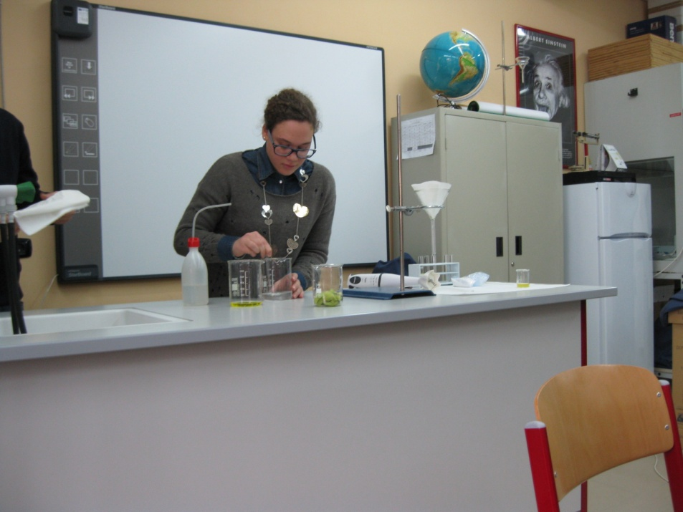
Going forwards
HOW TO INCREASE IMPACT?
Expand range of topics
Debate-programming
Create more flexibility in the timetable
More participation conducive spaces
Flip the classroom
Use more online content
Strengthen collaboration with local U’s
EDX ?

Slide 7
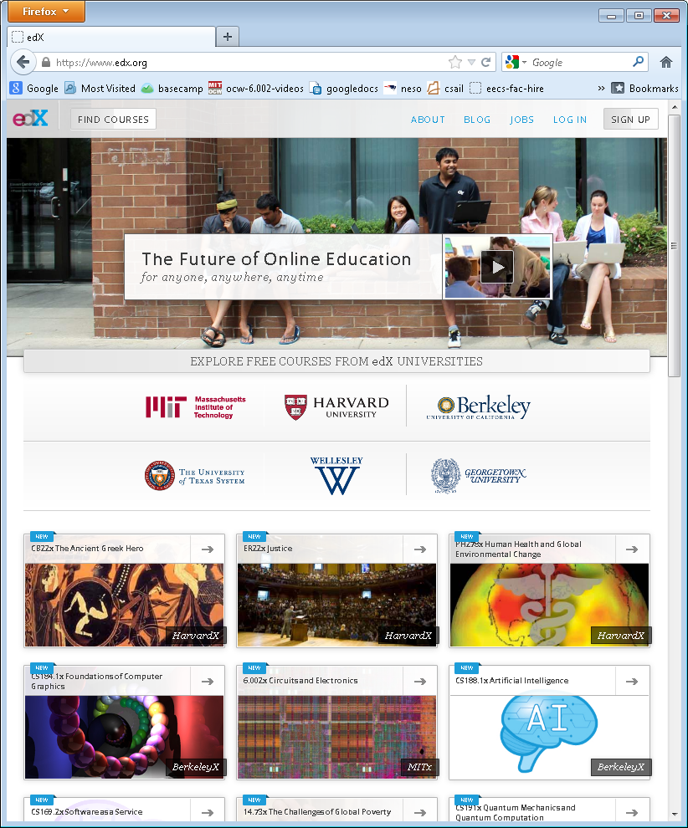
A Not For Profit Venture of Harvard & MIT
Open source Platform
Portal for learning edx.org
Harvard → HarvardX
MIT → MITx
Berkeley → BerkeleyX
U → Ux
X university consortium
Pedagogy research on learning using “big data”
Production support to ensure high quality
*Harvard and MIT have committed $60M to the venture

Slide 8
Vision
Expand access to education for students worldwide through online learning, while reinventing campus education through blended models

Slide 9



Admitted
~1600
Applied to MIT 2015
~18,000

Slide 10
Flipping the Funnel
7,157
Certified
8,240
Took the Final
9,318
Passed the Mid-Term
10,547
Made it the Mid-Term
26, 349
Tried the First Problem Set
154,763
Registered for 6.002x: Circuits and Electronics
Same staff resources as 150 person on-campus class

Slide 11
Results from edX in a Silicon Valley, California Campus
San Jose State University EE99
Flipped classroom with 86 students, Fall 2012 using edX MITx circuits and electronics MOOC class hosted by edX
Outside class:
      Watch edX MITx circuits and electronics video lectures
      Do online interactive exercises (homeworks and exams)
      Do online virtual simulation based laboratories
In class:
      The instructor answers questions in the first 15 minutes of class
      Students solve problems in groups of 3 with help from the instructor and two TAs. (15% of the course grade).

Slide 12
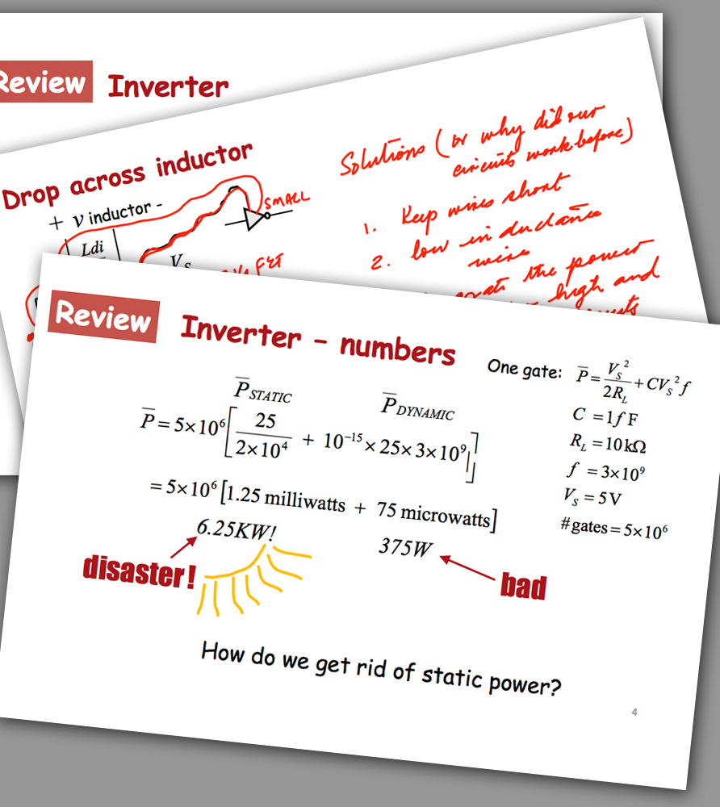
Preliminary Findings
Compared to the students enrolled in the Spring 2012 EE99 course, the Fall 2012 students:
Scored an average of 5.7% higher on the Midterm 1 exam and average of 9.6% higher on the Midterm 2 exam
Overall Result:
Course retake rate drops from 41% to 9%
Source: San Jose State University College of Engineering
Notes:
SJSU-
Total of 87 students in the course
Students viewed lectures and completed problems outside of class.
During class, faculty and course staff facilitated 15 minutes of question and answer. Remaining time on peer and team instruction and problem solving.
Instructors and TAs hired as graders are spending less time on grading work due to edX courseware. This frees their time up for instruction and work with students in class.
Next Step: Offer edX section again in Spring 2013- study more deeply.

Slide 13
Learning Sequences Promote Active Learning
Tell me and I forget.
Teach me and I remember.
Involve me and I learn.
– Benjamin Franklin
Learning and retention is related to depth of mental processing.
– Craik and Lockhart, 1972

Slide 14
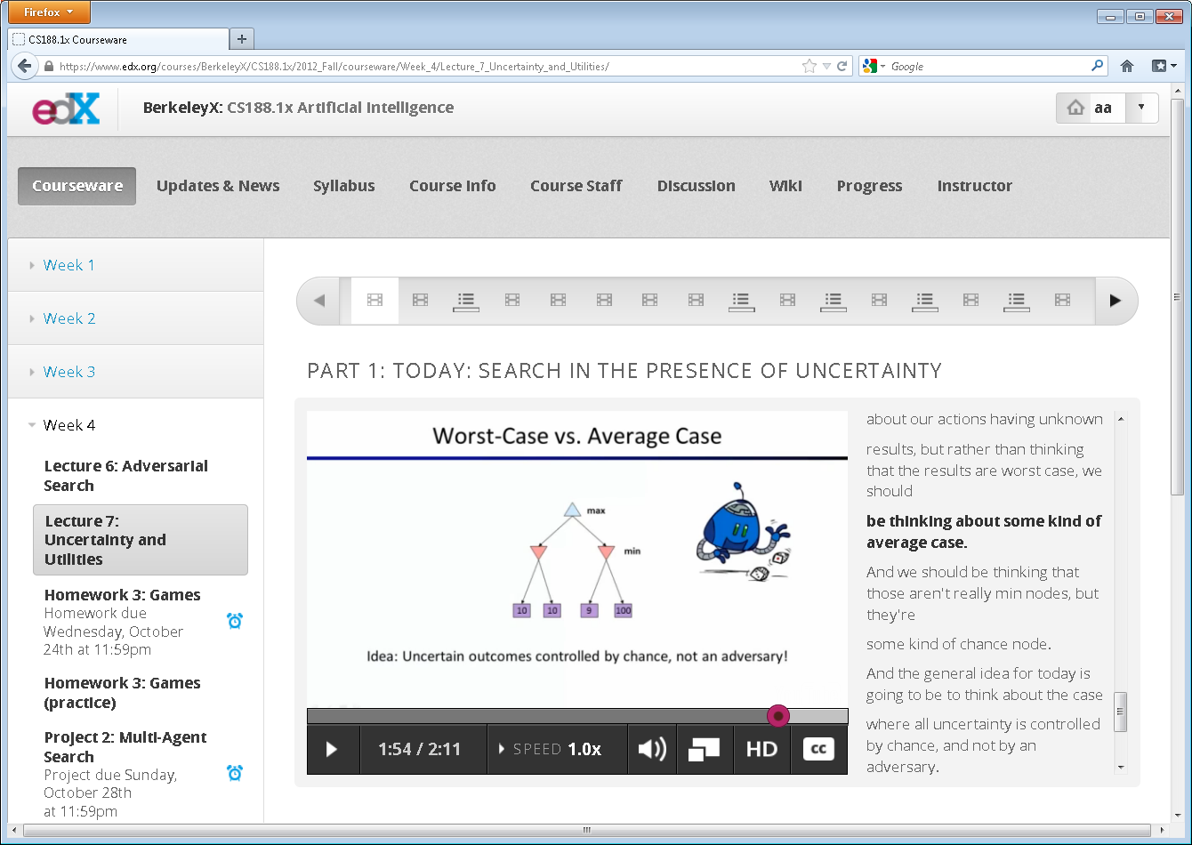
Anatomy of an edX Online Class

Slide 15
Student Controlled Pacing Improves Learning
Students who were able to press a
continue button to go on to the next segment performed better…
– Mayer 2003
J. educational computing research

Slide 16
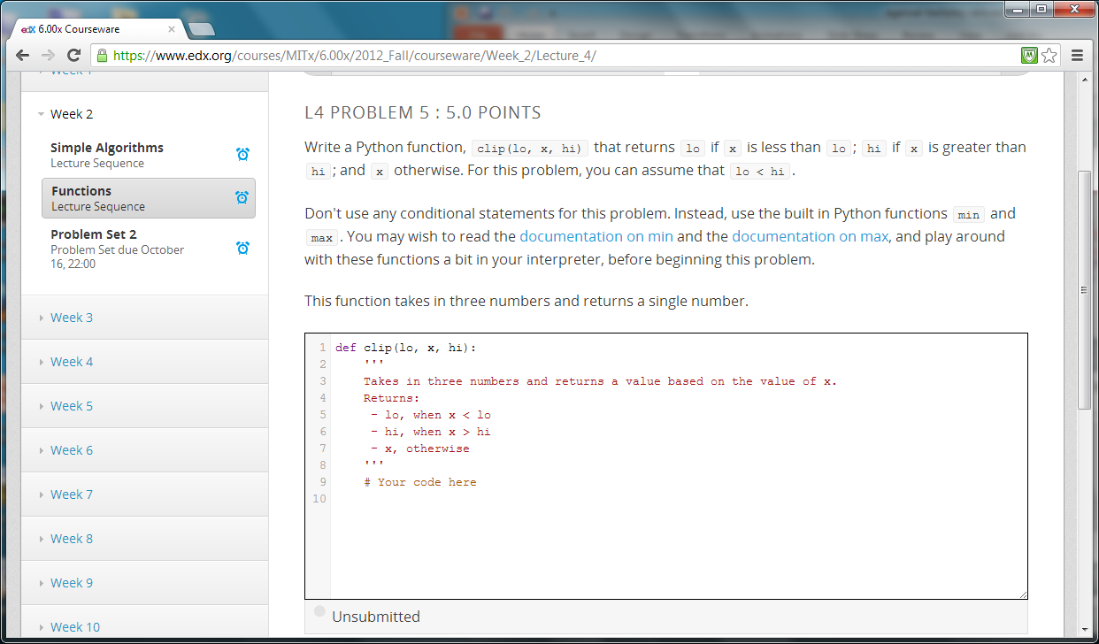
Programming Exercise

Slide 17
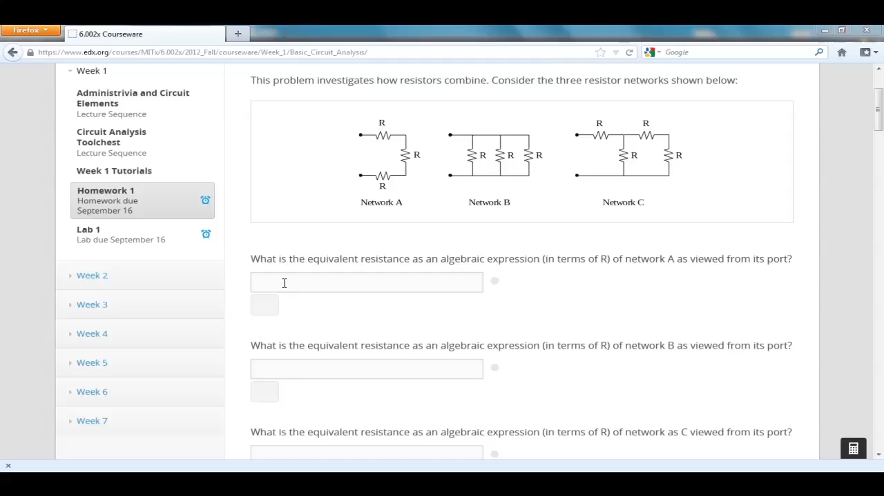
Autograded Exercises Provide Instant Feedback

Slide 18
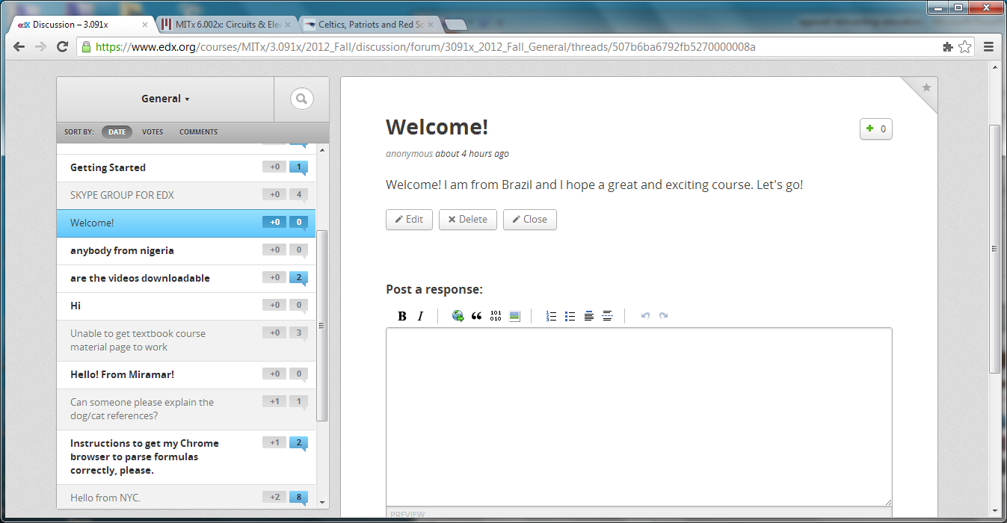
Discussion Forum
*

Slide 19
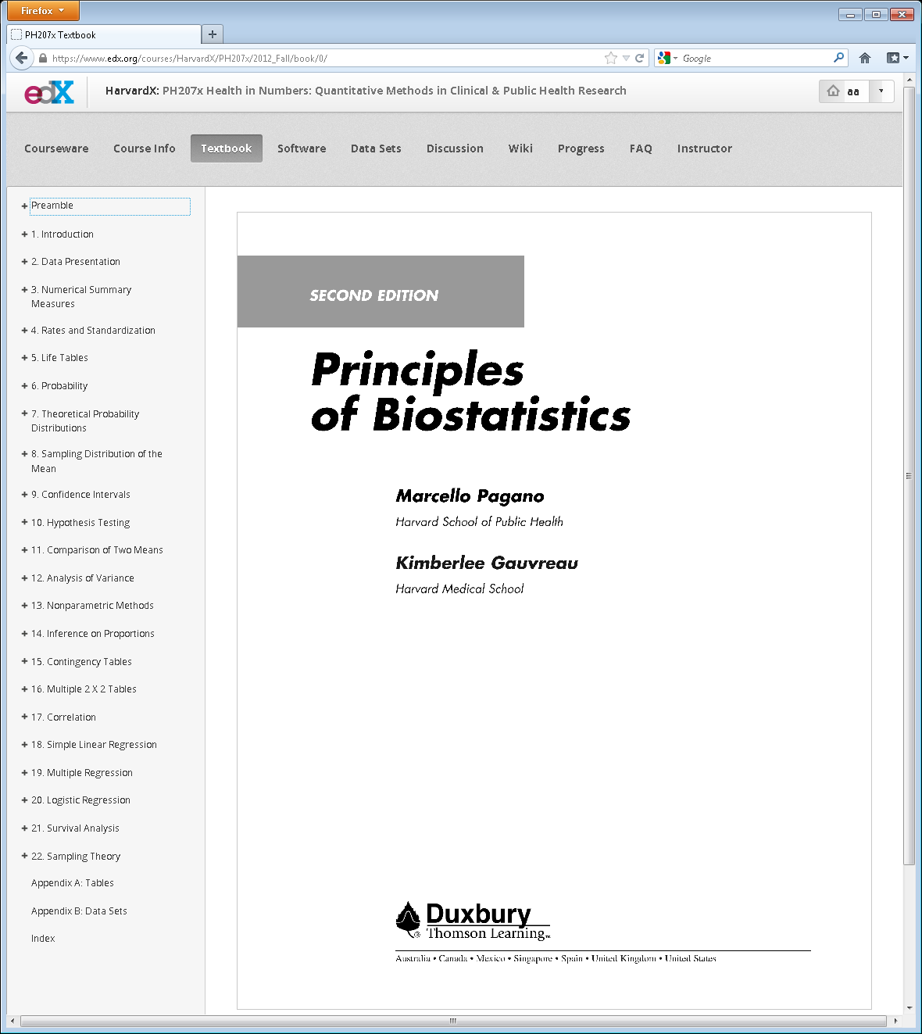
Free Online Textbooks

Slide 20

https://www.edx.org/school/mitx/allcourses
8.MReVx: Mechanics ReView
Mechanics ReView presents a college-level introductory mechanics class using a strategic problem-solving approach. more
Starts: 1 Jun 2013
•
Instructors: Dr. David E. Pritchard
•
MITx
https://www.edx.org/course/mit/8-mrevx/mechanics-review/748

