Slide 1

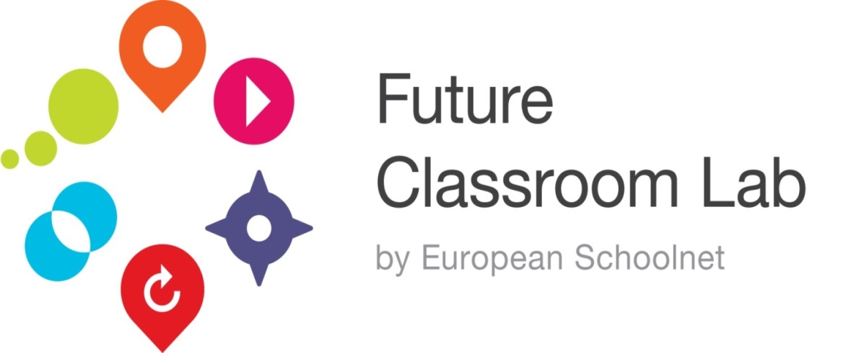
Future Classroom Lab
www.fcl.eun.org

Slide 2
European Schoolnet
Network of 30 Ministries
of Education in Europe
Dedicated to
Support schools in
bringing about the best use
of technology in learning
Promote the European
dimension in schools
and education
Improve and raise
the quality of education
in Europe
Transformation of Teaching and Learning Processes

Slide 3





Support to schools and teachers
School networking
eSafety
Insafe
eSafety label
Teachtoday
European
education network
Community
of practices
(teachers, pupils)
eTwinning, games, competition,
campaigns
STEM
InGenious
Scientix

Slide 4
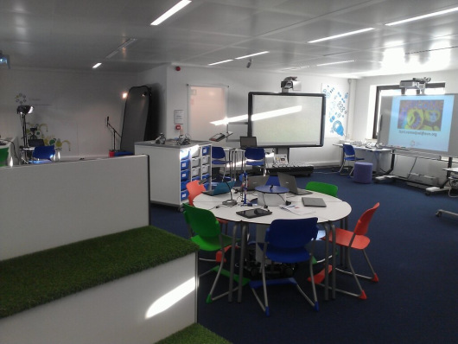
Future Classroom Lab

Slide 5
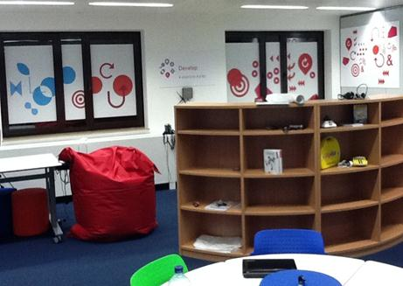
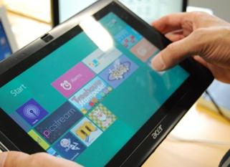
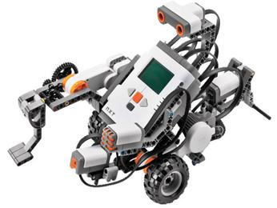
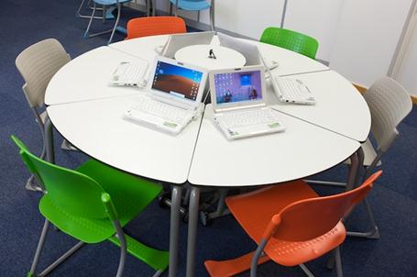
Future Classroom Lab
A space for policy makers, companies and teachers to rethink future learning strategies
A flexible learning space with state-of-the-art technology to experiment with different styles of learning

Slide 6
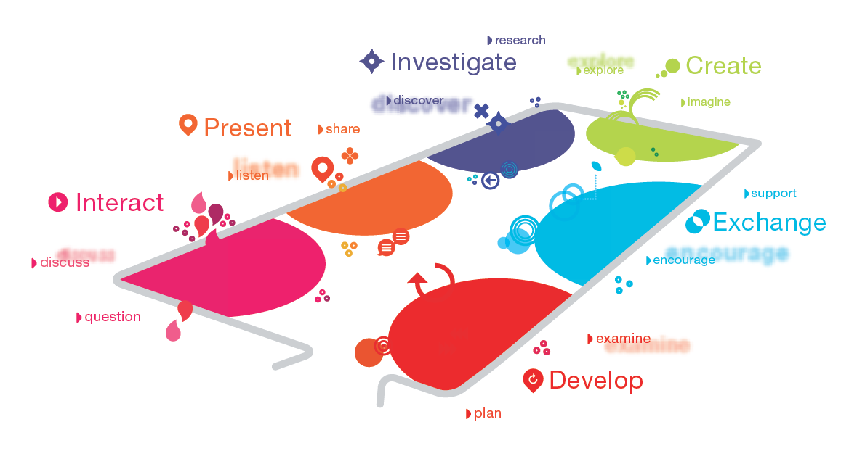
Six different zones

Slide 7






















FCL Sponsors
Sponsors

Slide 8

A quick overview

Slide 9
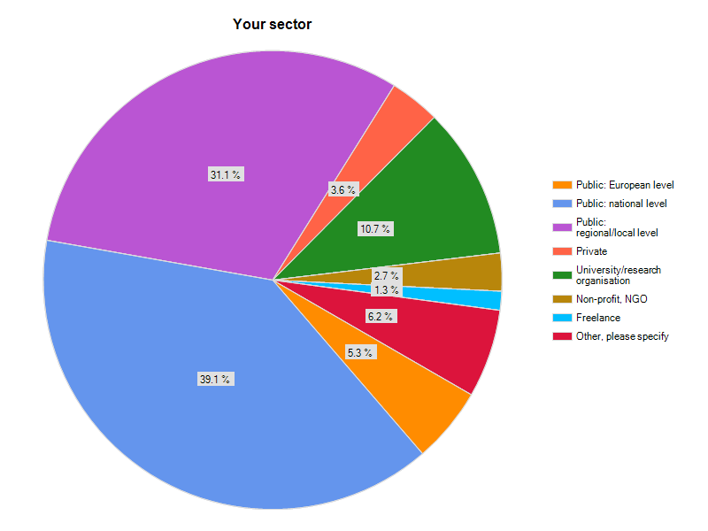
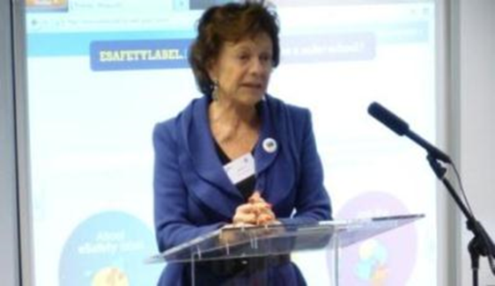
Activity in the Lab
FCL “Footfall”: over 1,300 visitors since launch
Events
Training
Projects
Commission
Regions
Ministries
Overseas
Local
Registered Visitors:
July 2012 to April 2013
n=225 (online questionnaire)

Slide 10
Creative use of multimedia workshop

Slide 11
iTEC project
Developing and testing future classroom scenarios in >1,000 classrooms
Involving 17 Ministries of Education
Future Classroom Lab will enable us to demonstrate and run courses related to iTEC scenarios
Helping stakeholders to rethink and test designs for the future classroom

Slide 12
CPDLab project
Developing 3 modular courses for continuing professional development
  Future Classroom Scenarios
  Innovative use of Interactive Whiteboards
  eSafety
Courses will be run in the Future Classroom Lab (June 2013) and online

Slide 13
Living Schools Lab project
Developing a network of best practice and validation schools in Europe
  24 Advanced Schools
  60 Advanced Practitioners
  To showcase and scale up best practice
  To support action based research
12 Ministries of Education

Slide 14
Creative Classrooms project
Tablet scenarios that can be mainstreamed
First pilots October/November 2013
9 Ministries of Education
Associate Partners: Acer, Microsoft, NEC, Samsung, SMART, Texas Instruments

Slide 15

Future Developments

Slide 16
Future Classroom Lab
www.fcl.eun.org

